Slide 1
Threddz Snapchat Campaign
Trisha werner, Greg havenner, Jesus Villarreal

Slide 2
Warren Buffett
“It takes 20 years to build a reputation and five minutes to ruin it. If you think about that, you'll do things differently.”

Slide 3
Mission Statement
Our mission is to be one of the leading sustainable designer lifestyle brands through creating our inclusive product that embodies the freedom and spirit of youth, managing our operations, and connecting with our community and stakeholders.

Slide 4
Core Values
Supporting the growth of healthy communities
Empowering people
Embracing diversity
Adhering to human rights standards
Producing 100% of our cotton from more sustainable sources

Slide 5
Problem Statement
In order to be one of the leading sustainable designer lifestyle brands, Threddz needs to launch a communication program on Snapchat to repair its tarnished reputation and rehabilitate a tainted corporate image.

Slide 6
#1: Decide What Type of Content to Post
Share a story focused on an event you’re attending or hosting. This will help you tell your brand’s story, and add value at the same time.
a. Before: provide awareness about the event to your audience
b. During: share keynotes, cool exhibitors, and fun activities
c. After: focus on key event takeaways, your opinions on the event, and specific after-event calls to action

Slide 7
#2: Grow a Targeted Audience
Snapchat helps you gain exposure and grow your business. Here are some creative ways you can give people a reason to follow you:
Leverage other platforms to share unique content
Do a social media search to share your story on other platforms
Run social media competitions
Promote your Snapcode on business cards

Slide 8
#3: Engage Your Audience
Remember to engage with your audience. It’s crucial.
Ask meaningful questions (vote on logo designs or give feedback)
Engage proactively with other users t spark conversation
Entice users to create snaps and feature them on your Snapchat story

Slide 9
#4: Measure Performance
To drive results and continuous improvement through Snapchat, you have to measure your Snapchat performance. It’s crucial.
Measure your total story completions
Measure your unique views
Measure your screenshots
Measure and analyze website traffic
Notes:
These are four key metrics you can focus on within Snapchat analytics:
Using Snapchat effectively will help your business build exposure, credibility, and trust with your audience

Slide 10
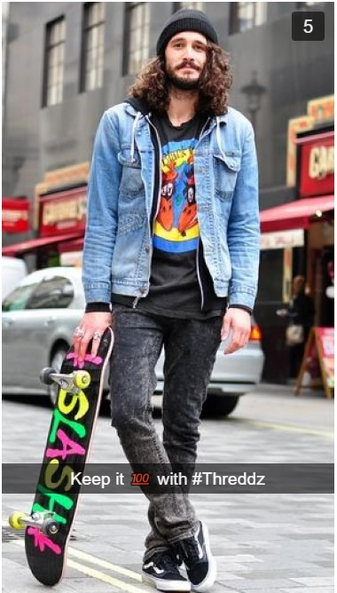

Slide 11
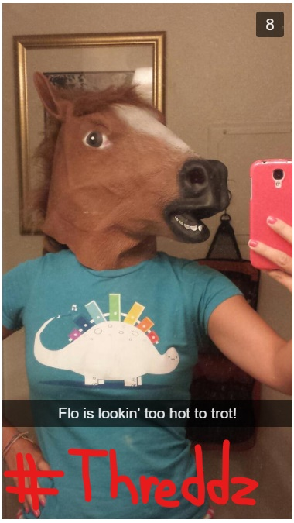

Slide 12
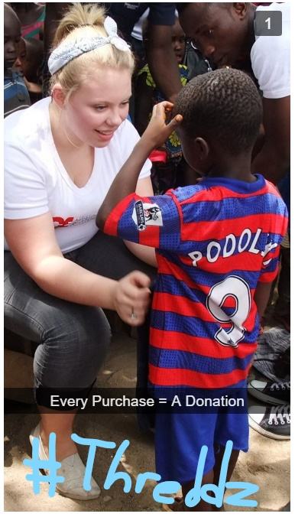

Slide 13
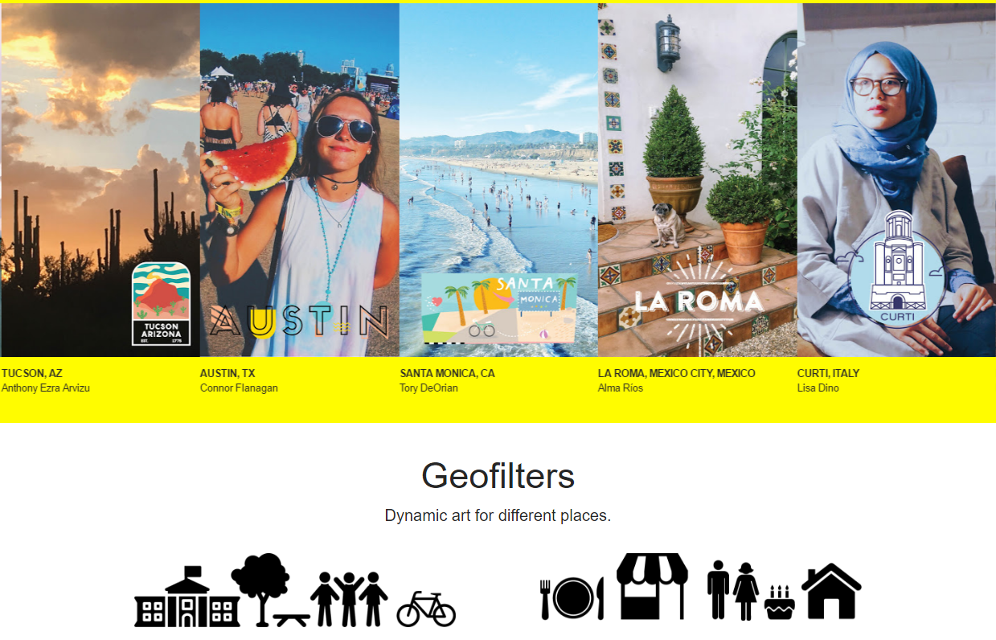
Geofilters and Previews

Slide 14
Snapchat is a springboard to other Social Media channels

Slide 15
SMART Objective
Increase legitimacy of the brand and make it appealing to parents of 12-18 year olds. Ensure, by January, that Threddz is a clothing brand parents would consider purchasing for their kids from 20% to 50% in surveys.
Smart
Measurable
Agreed upon
Realistic
Time-related

Slide 16
Legal Considerations
False testimonials (FTC violation)
Expansion of this campaign increases the need for risk management...
And obviously, don't take pictures of anyone doing anything illegal.

